Slide 1
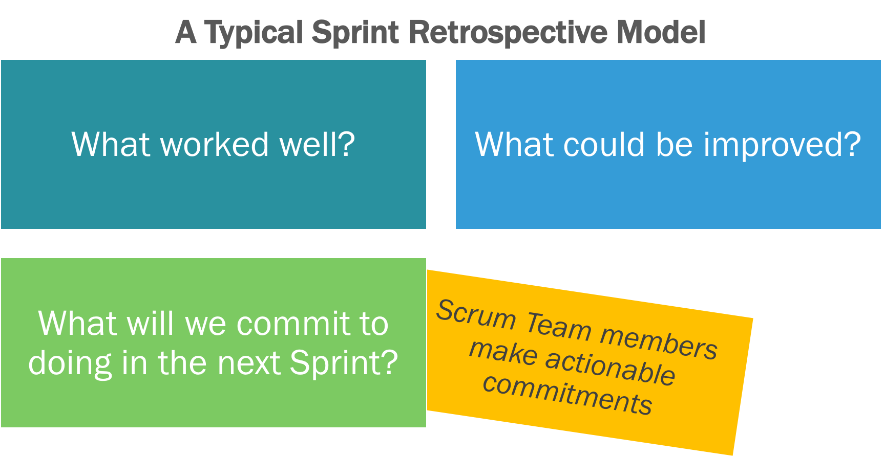
SPRINT RETROSPECTIVE
The retrospective is a collaborative process among all members, including the team, the product owner, and the Scrum Master.

Slide 2
Benefits of Retrospective:
Process improvements are made at the end of every sprint. This ensures that the project team is always improving the way it works.
All team members identify what went well and what could be improved.
The team members discuss the process that they are following and give any suggestions for improvement.
The team members discuss any other ideas that could improve their productivity.
The Scrum Master prioritizes actions and lessons learned based on team direction.
The retrospective supports team formation and bonding, particularly as any areas of conflict can be identified and dealt with.
The retrospective helps build the team’s sense of ownership and its self-management.

